Slide 1


2023 ALA Minnesota Girls State
June 11-17 2023 Bethel University

Slide 2

Why send a Citizen to ALA MN Girls State?
It will give them a greater understanding of our Government and how it functions through an immersive, interactive program.
It will foster a greater sense of Americanism and responsible Citizenship
They will develop friendships that can last a lifetime and learn to step outside their comfort zone.

Slide 3
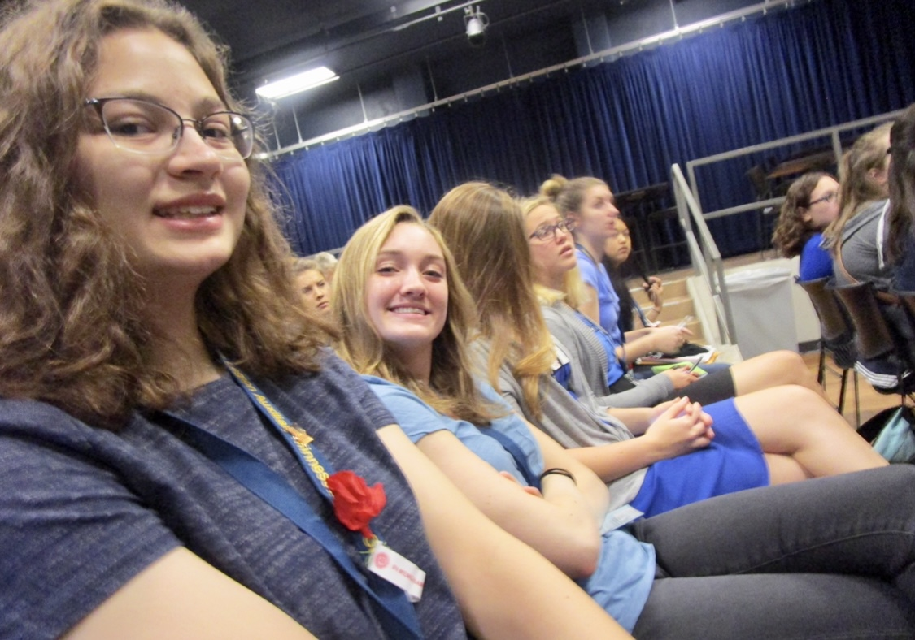
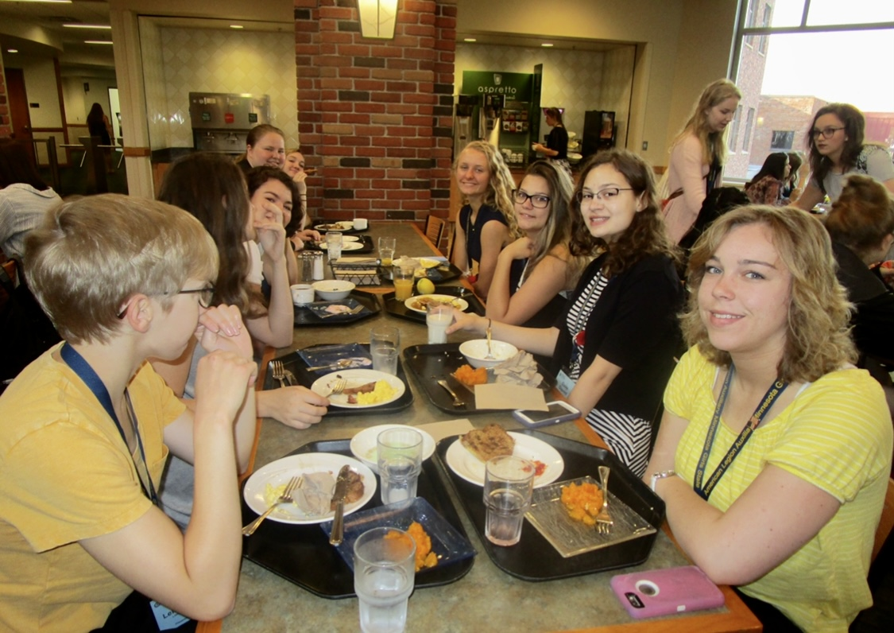
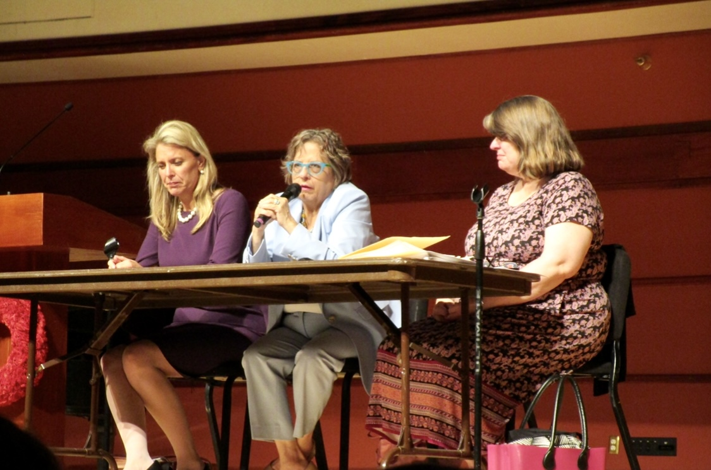
A week at ALA MN Girls State, what’s it like?
Sunday ~ Get Acquainted Day
Monday ~ City Day
Tuesday ~ County Day
Wednesday ~ Americanism Day
Thursday ~ Inauguration Day
Friday ~ Capital Day
Saturday ~ Farewell Day

Slide 4
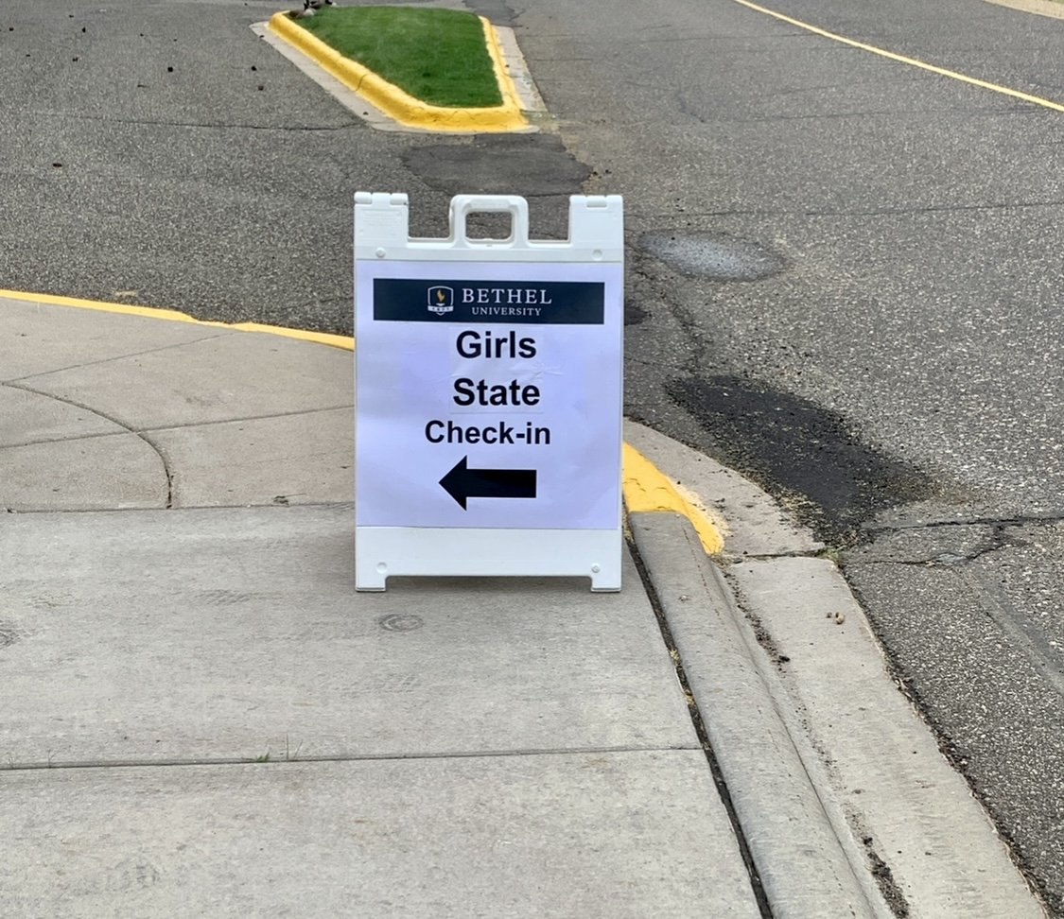
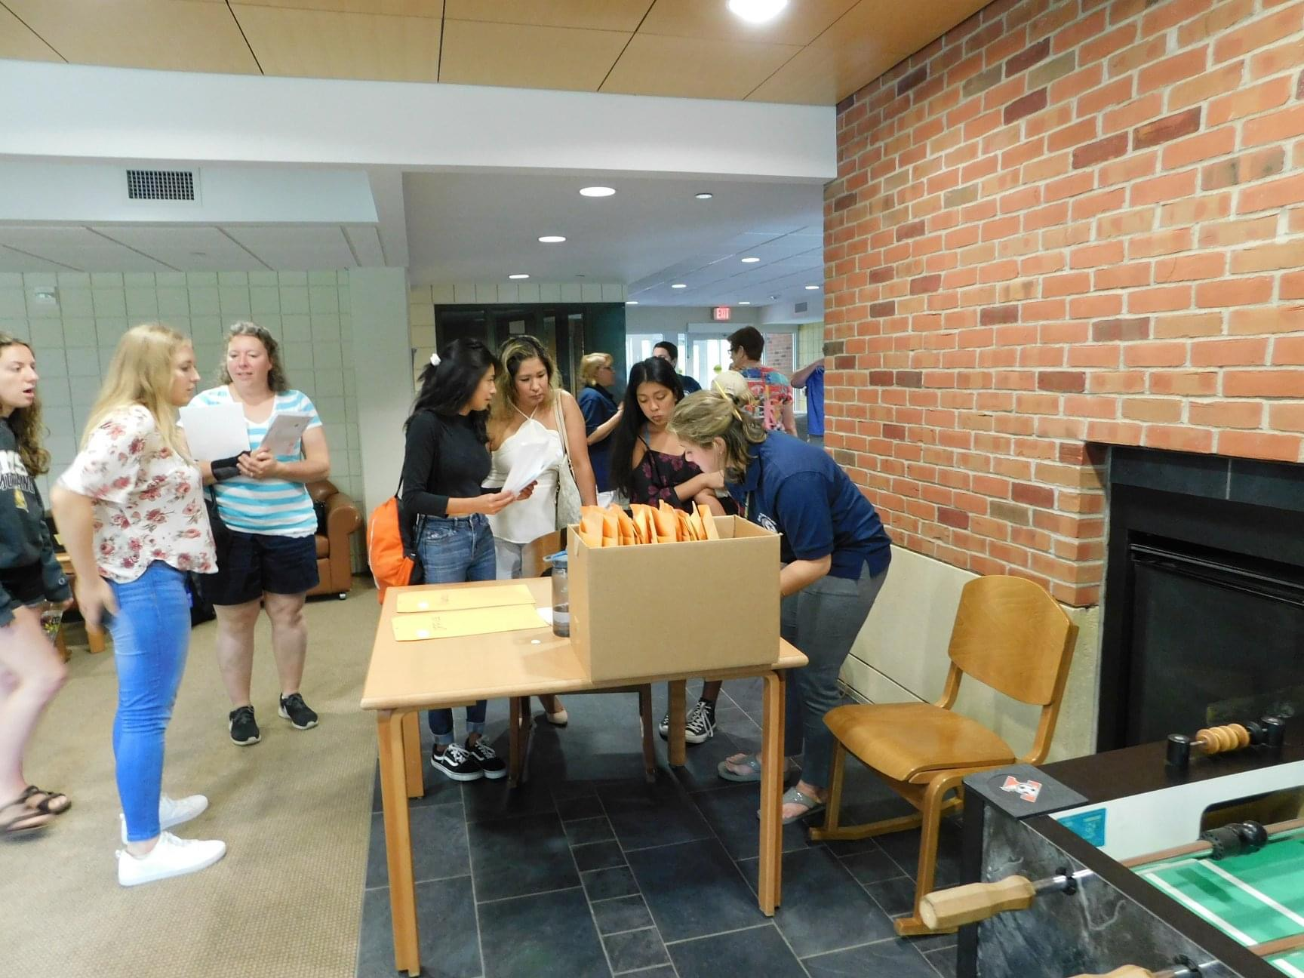
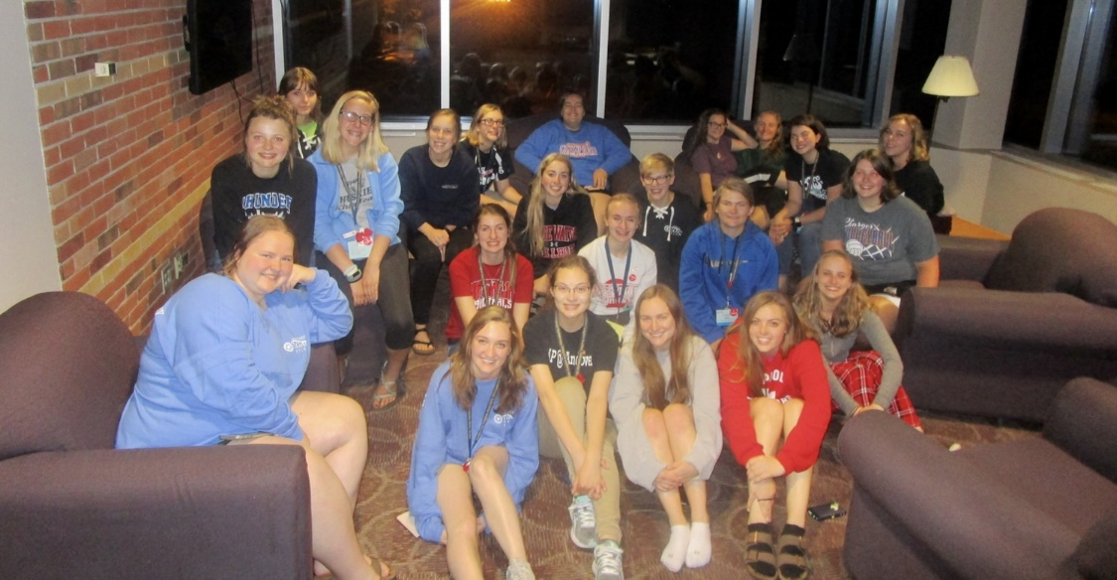
Sunday ~ Get Acquainted Day
Citizens check into their dorms
Citizens learn about city governments and begin to organize their cities and register to vote.

Slide 5
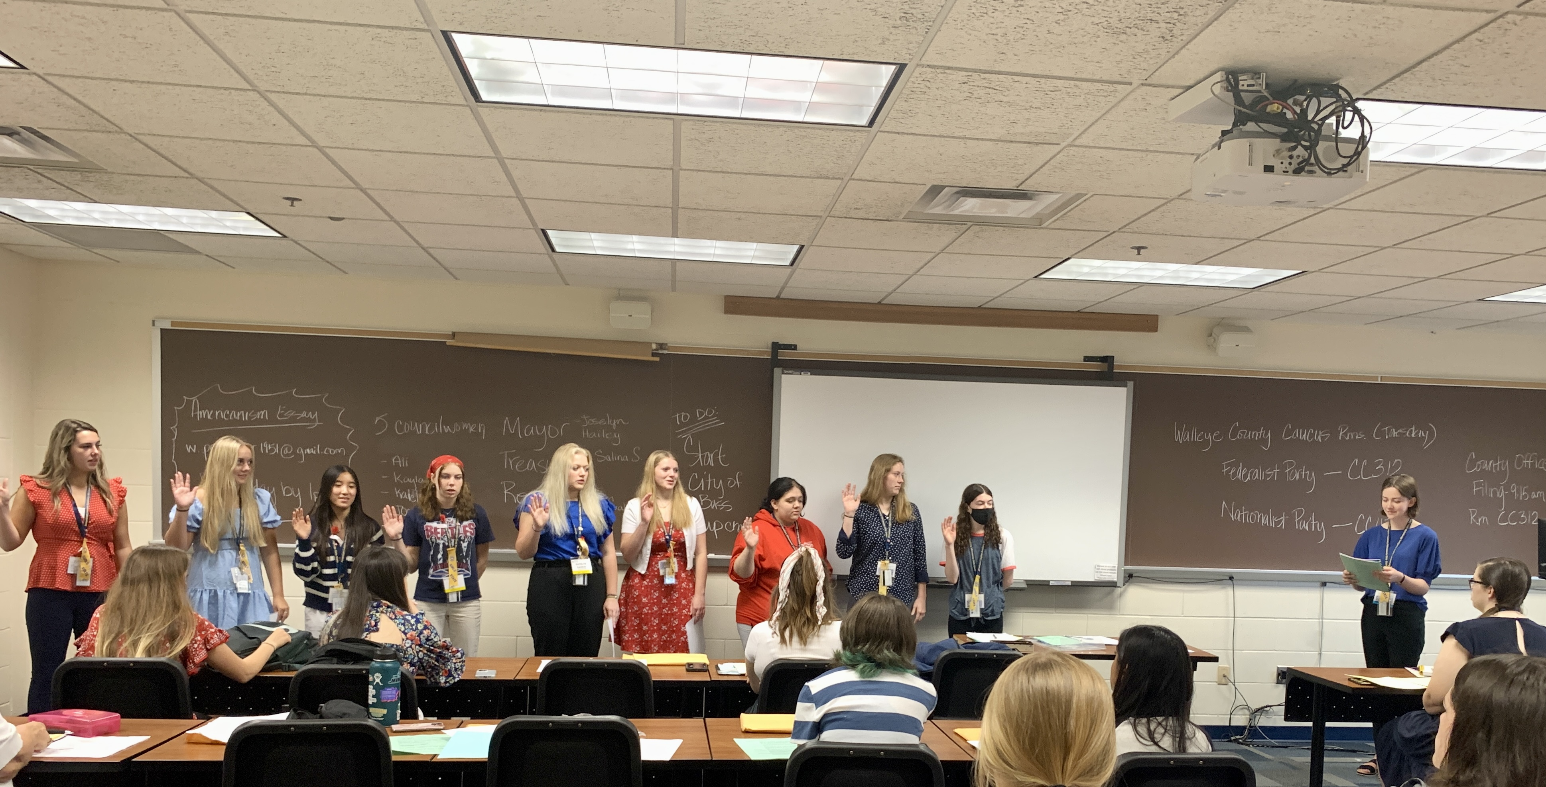
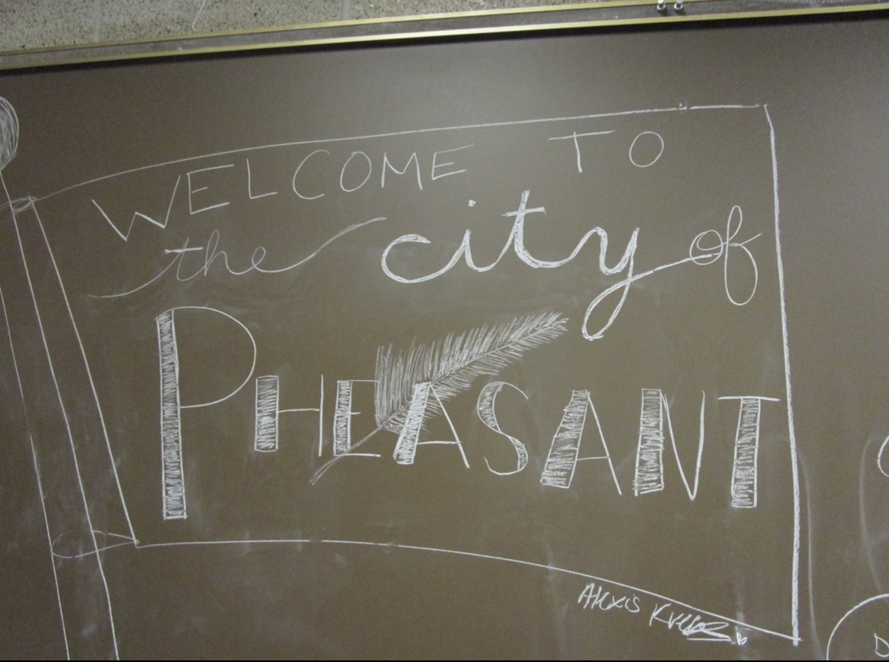
Monday ~ City Day
Citizens have City Meetings, decide on a form of government for their city and hold City elections.
Citizens hear from panelists on topics from City government, Judicial branches and Party officials
Citizens learn about Parliamentary Procedure, Parties and Party Caucuses
Campaigning begins for County offices

Slide 6
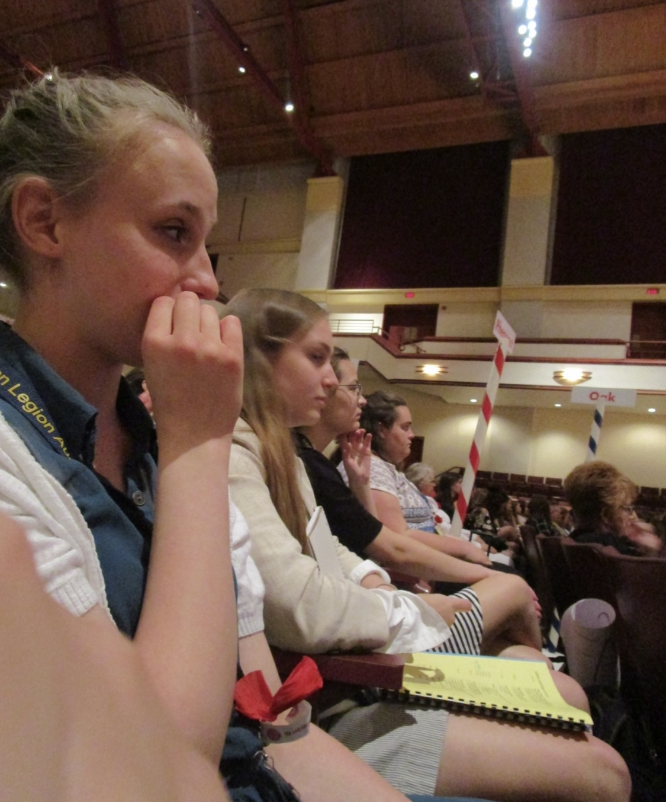
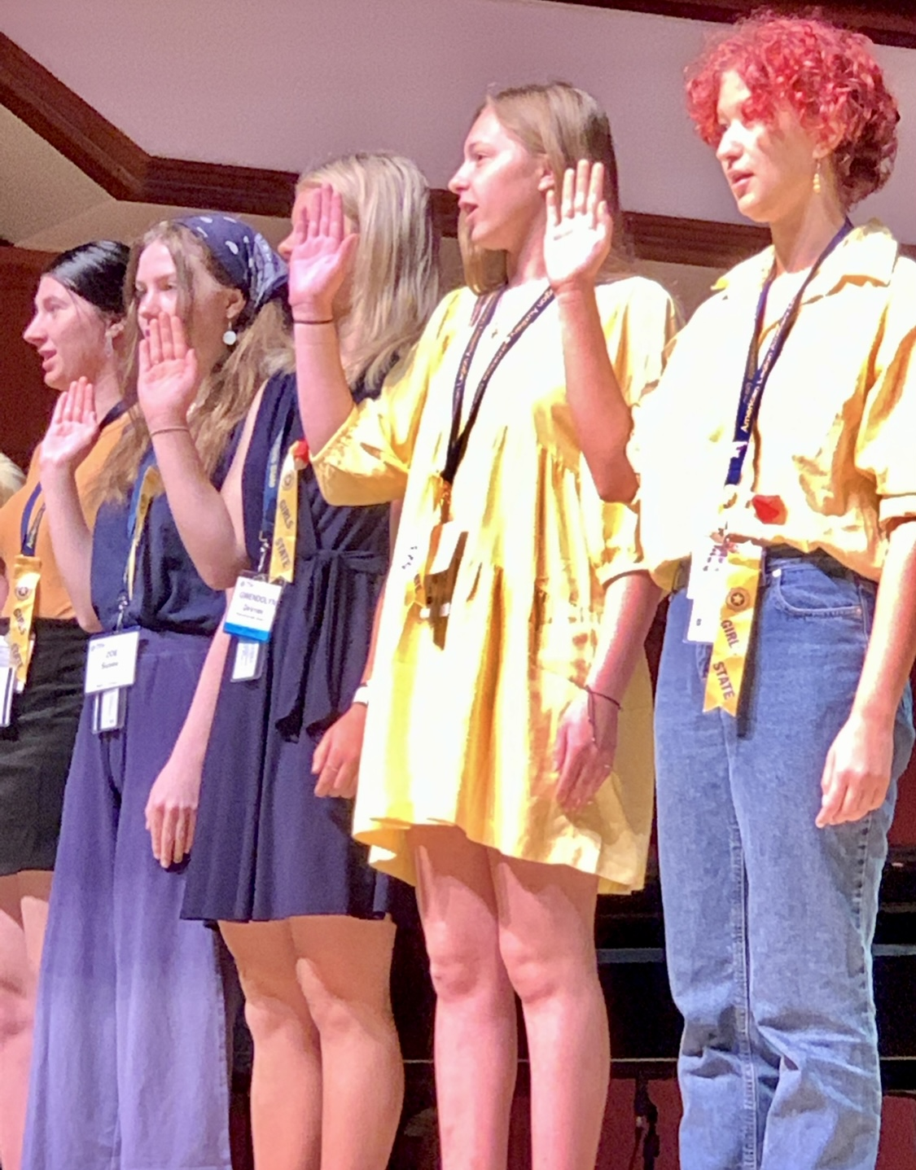
Tuesday ~ County Day
Citizens file for and run for County offices. County elections are held.
Citizens hear from a Panel of County government officials and speakers from the Legislative Branch.
County caucus meetings are held and Party platforms begin to develop
A panel from the Women’s Bar Association speaks
Campaigning begins for State Offices

Slide 7
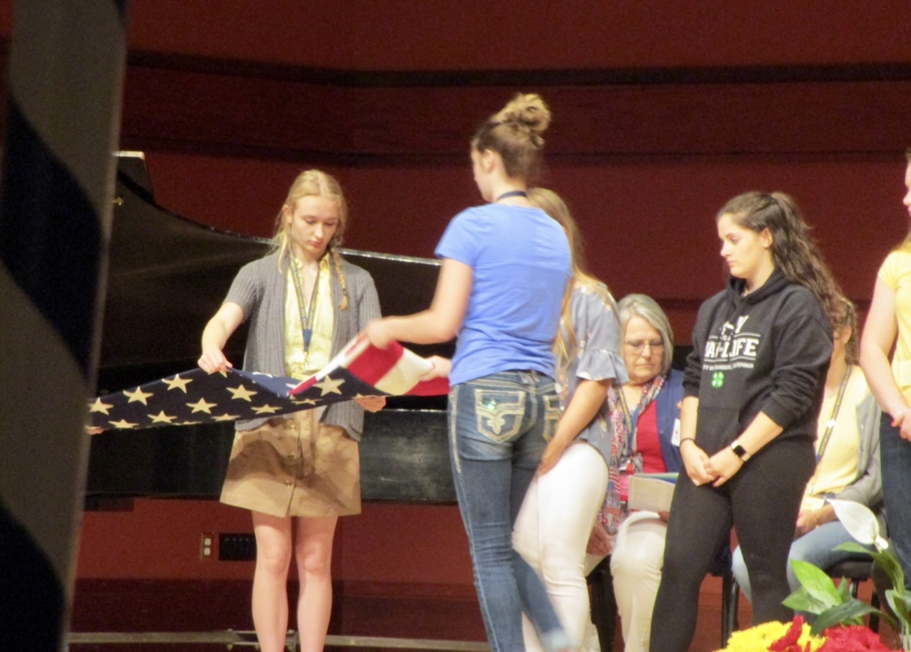
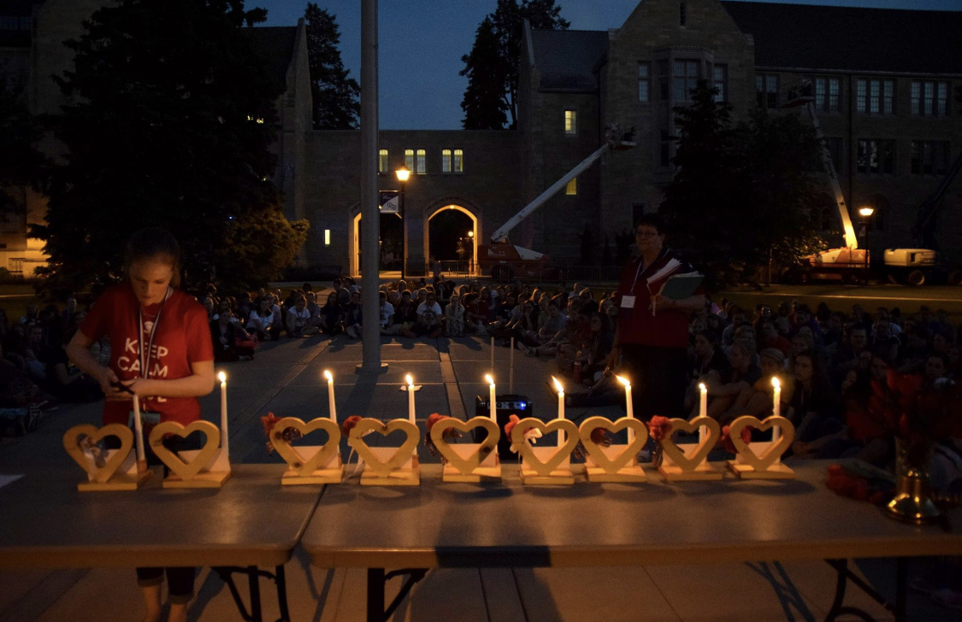
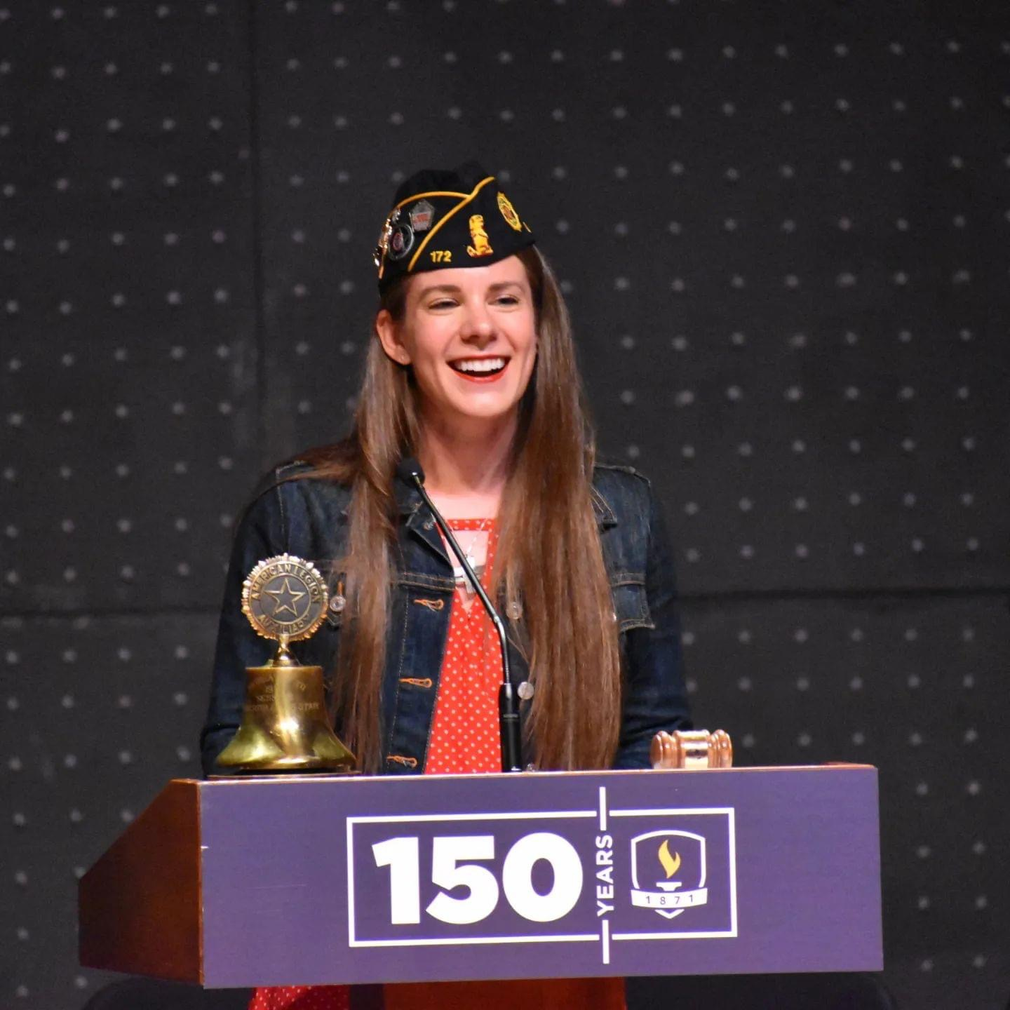
Wednesday ~ Americanism Day
Citizens file for State offices
County Meetings are held
State Party Conventions begin
State Primary and General Elections are held
Citizens hear from an Americanism speaker
Candlelight Ceremony is held
House and Senate as well as the Courts are organzied

Slide 8
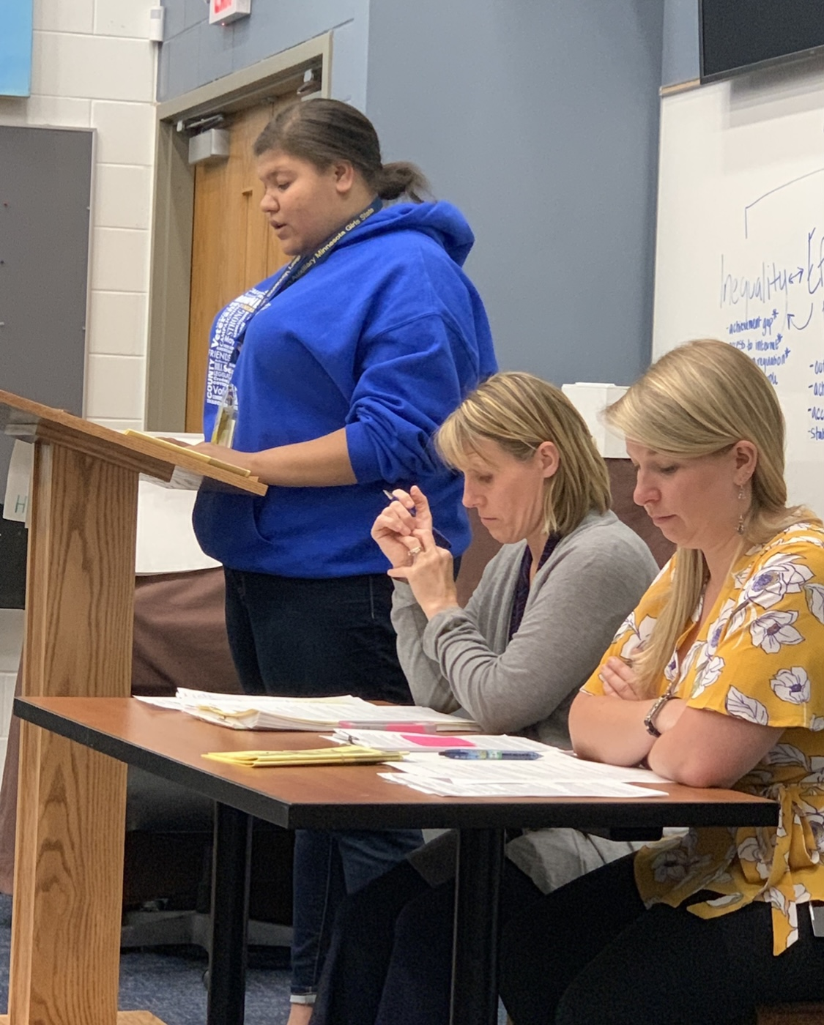
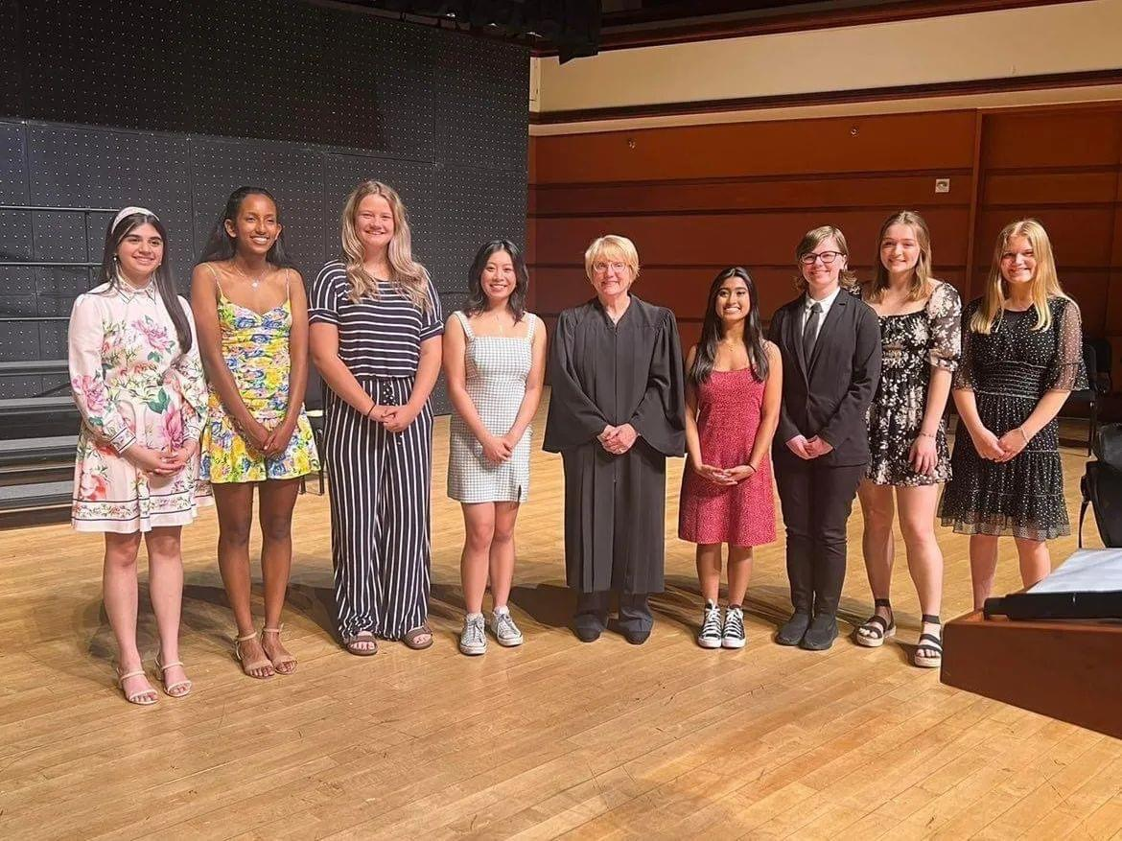
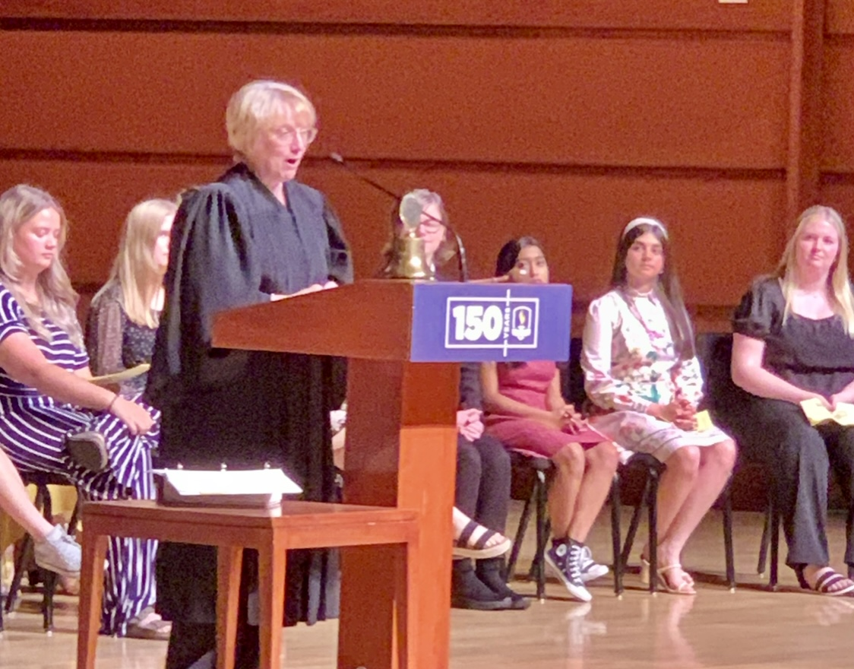
Thursday ~ Inauguration Day
The House and Senate Convene
Legislative consultants meet with Citizens and Bills are finalized
Mock Trials practiced
Inaguration

Slide 9
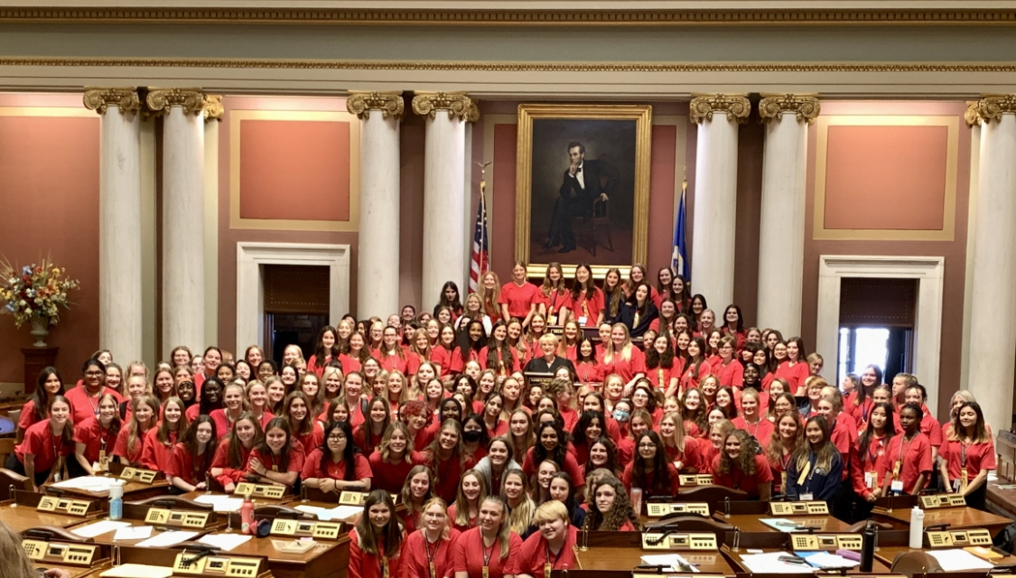
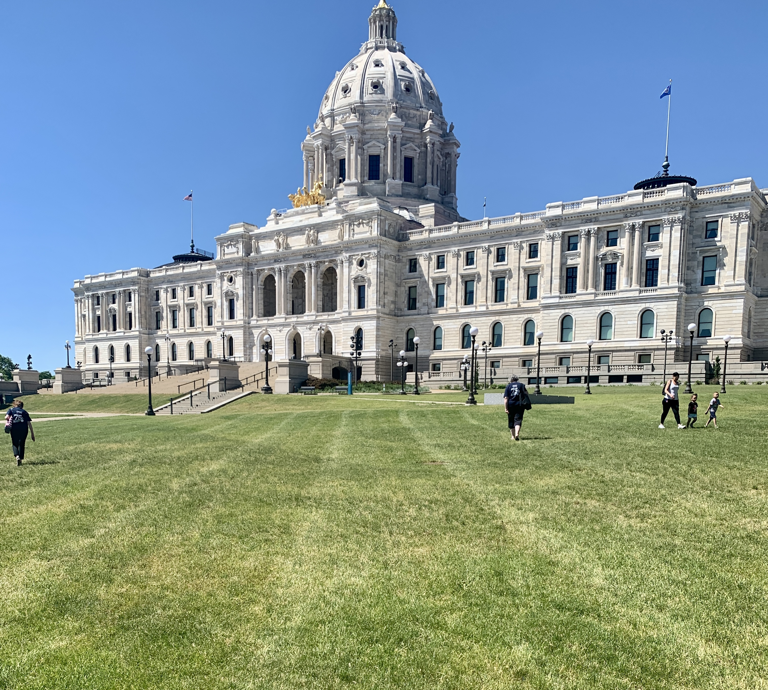
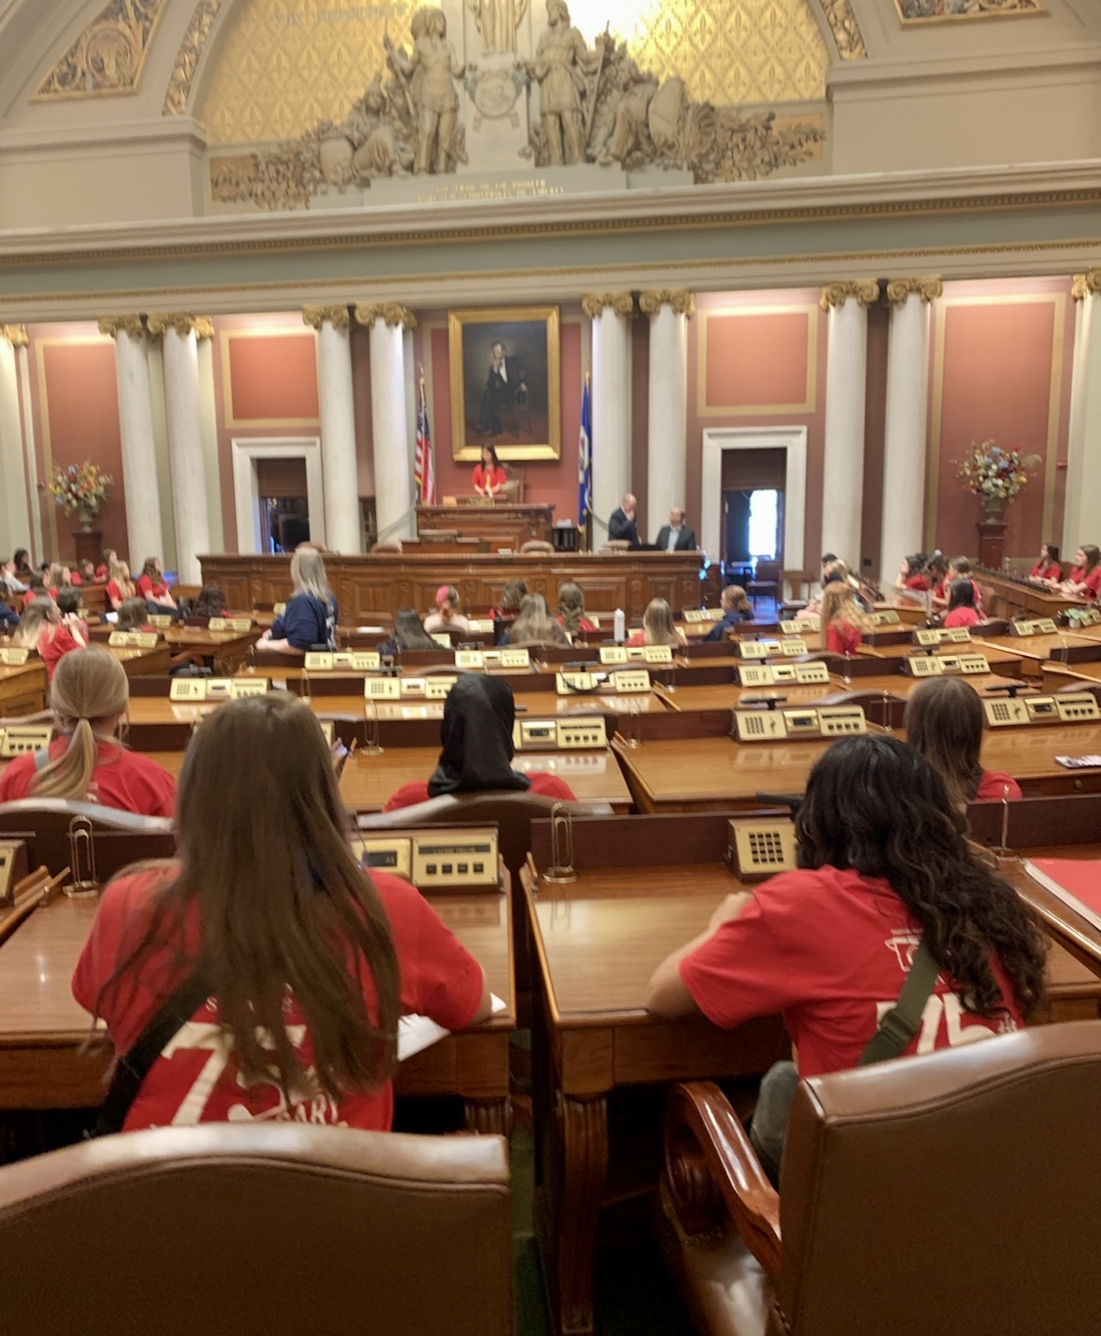
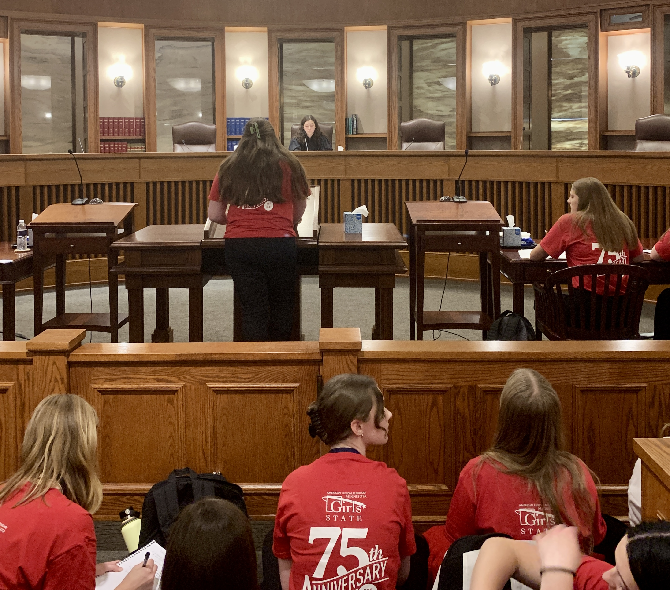
Friday ~ Capital Day
Citizens head to the Capital
Joint Session of Legislature is Convened
Mock Trials are conducted
Variety Show

Slide 10
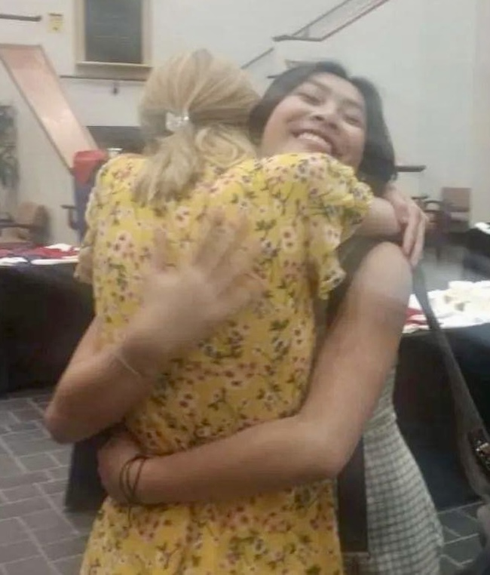
Saturday ~ Farewell Day
Citizens pack up and clean for departure
Governor gives her farewell address and review
Scholarship winners announced
Girls Nation Senators Announced
Adjournment
Head for home

Slide 11
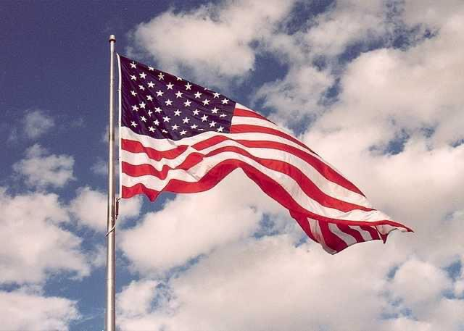
Questions?
As always you can contact anyone on the Girls State Committee for more information.

